Slide 1
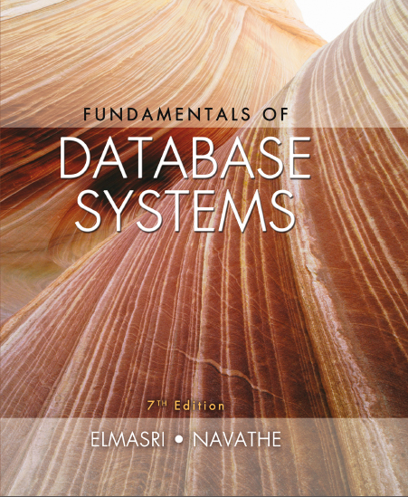
Fundamentals of Database Systems
Seventh Edition
Chapter 26
Enhanced Data Models: Introduction to Active, Temporal, Spatial, Multimedia, and Deductive Databases
Copyright © 2016, 2011, 2007 Pearson Education, Inc. All Rights Reserved
Notes:
If this PowerPoint presentation contains mathematical equations, you may need to check that your computer has the following installed:
1) MathType Plugin
2) Math Player (free versions available)
3) NVDA Reader (free versions available)

Slide 2
26.1 Active Database Concepts and Triggers
Database systems implement rules that specify actions automatically triggered by certain events
Triggers
Technique for specifying certain types of active rules
Commercial relational D B M S s have various versions of triggers available
Oracle syntax used to illustrate concepts

Slide 3
Generalized Model for Active Databases and Oracle Triggers
Event-condition-action (E C A) model
Event triggers a rule
Usually database update operations
Condition determines whether rule action should be completed
Optional
Action will complete only if condition evaluates to true
Action to be taken
Sequence of S Q L statements, transaction, or external program

Slide 4
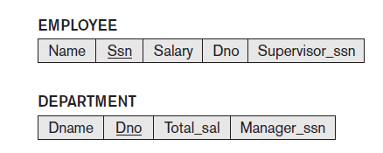
Example (1 of 2)
Events that may cause a change in value of Total_sal attribute
Inserting new employee
Changing salary
Reassigning or deleting employees
Figure 26.1 A simplified COMPANY database used for active rule examples

Slide 5
Example (2 of 2)
Condition to be evaluated
Check that value of D n o attribute is not NULL
Action to be taken
Automatically update the value of Total_sal

Slide 6
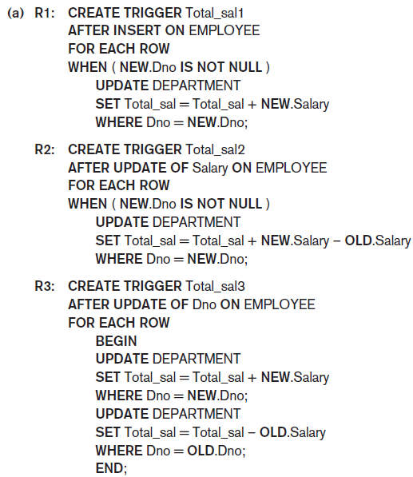
Figure 26.2 Specifying Active Rules as Triggers in Oracle Notation (1 of 2)
(a) Triggers for automatically maintaining the consistency of Total_sal of DEPARTMENT

Slide 7
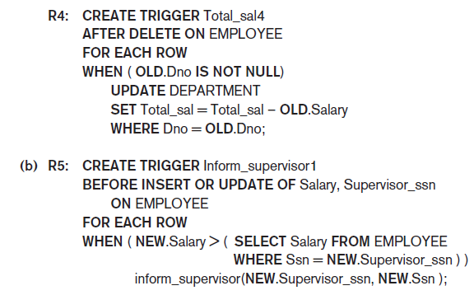
Figure 26.2 Specifying Active Rules as Triggers in Oracle Notation (2 of 2)
(b) Trigger for comparing an employee’s salary with that of his or her supervisor

Slide 8
Design and Implementation Issues for Active Databases (1 of 4)
Deactivated rule
Will not be triggered by the triggering event
Activate command
Makes the rule active again
Drop command
Deletes the rule from the system
Approach: group rules into rule sets
Entire rule set can be activated, deactivated, or dropped

Slide 9
Design and Implementation Issues for Active Databases (2 of 4)
Timing of action
Before trigger executes trigger before executing event that caused the trigger
After trigger executes trigger after executing the event
Instead of trigger executes trigger instead of executing the event
Action can be considered separate transaction
Or part of same transaction that triggered the rule

Slide 10
Design and Implementation Issues for Active Databases (3 of 4)
Rule consideration
Immediate consideration
Condition evaluated as part of same transaction
Evaluate condition either before, after, or instead of executing the triggering event
Deferred consideration
Condition evaluated at the end of the transaction
Detached consideration
Condition evaluated as a separate transaction

Slide 11
Design and Implementation Issues for Active Databases (4 of 4)
Row-level rule
Rule considered separately for each row
Statement-level rule
Rule considered once for entire statement
Difficult to guarantee consistency and termination of rules

Slide 12
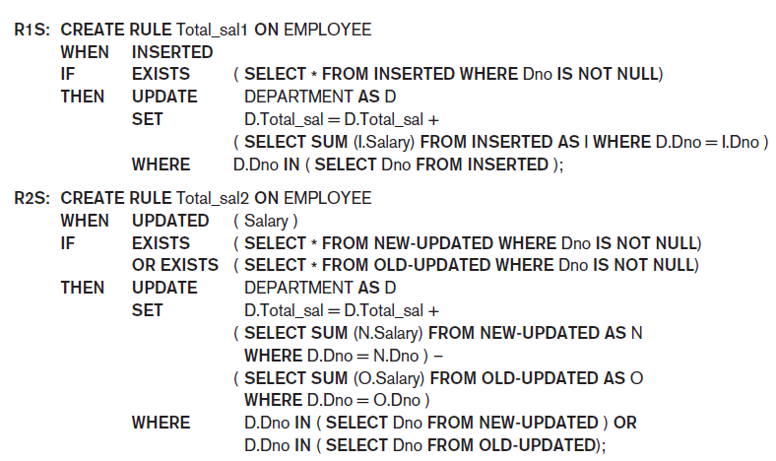
Examples of Statement-Level Active Rules in STARBURST (1 of 2)
Figure 26.5 Active rules using statement-level semantics in STARBURST notation

Slide 13
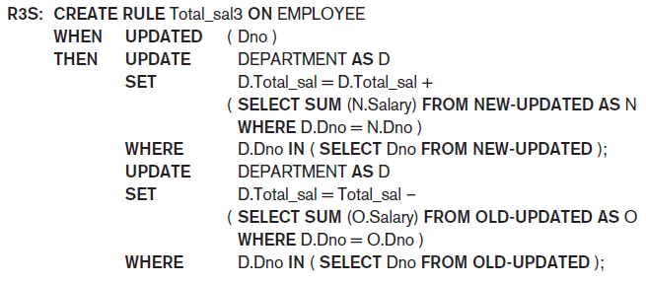
Examples of Statement-Level Active Rules in STARBURST (2 of 2)
Figure 26.5 Active rules using statement-level semantics in STARBURST notation

Slide 14
Potential Applications for Active Databases
Allow notification of certain conditions that occur
Enforce integrity constraints
Automatically maintain derived data
Maintain consistency of materialized views
Enable consistency of replicated tables

Slide 15
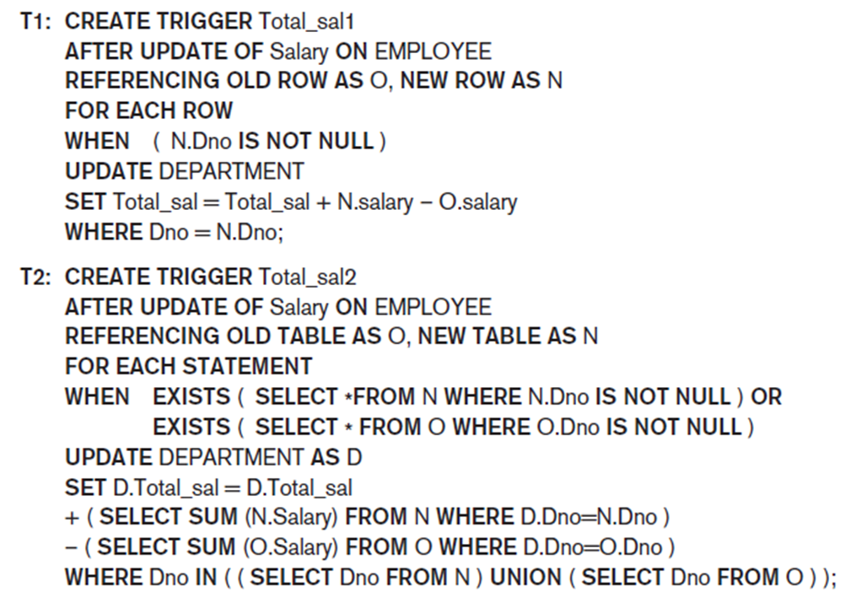
Triggers in S Q L-99
Figure 26.6 Trigger T1 illustrating the syntax for defining triggers in S Q L-99

Slide 16
26.2 Temporal Database Concepts (1 of 12)
Temporal databases require some aspect of time when organizing information
Healthcare
Insurance
Reservation systems
Scientific databases
Time considered as ordered sequence of points
Granularity determined by the application

Slide 17
Temporal Database Concepts (2 of 12)
Chronon
Term used to describe minimal granularity of a particular application
Reference point for measuring specific time events
Various calendars
S Q L2 temporal data types
DATE, TIME, TIMESTAMP, INTERVAL, PERIOD

Slide 18
Temporal Database Concepts (3 of 12)
Point events or facts
Typically associated with a single time point
Time series data
Duration events or facts
Associated with specific time period
Time period represented by start and end points
Valid time
True in the real world

Slide 19
Temporal Database Concepts (4 of 12)
Transaction time
Value of the system clock when information is valid in the system
User-defined time
Bitemporal database
Uses valid time and transaction time
Valid time relations
Used to represent history of changes

Slide 20
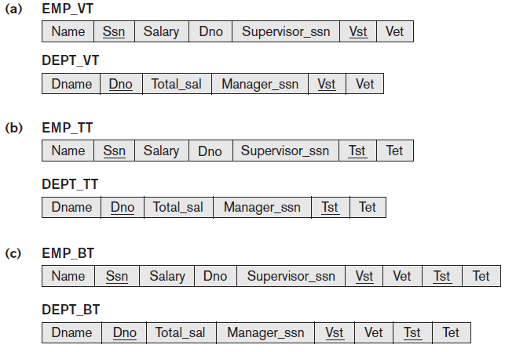
Temporal Database Concepts (5 of 12)
Figure 26.7 Different types of temporal relational databases (a) Valid time database schema (b) Transaction time database schema (c) Bitemporal database schema

Slide 21
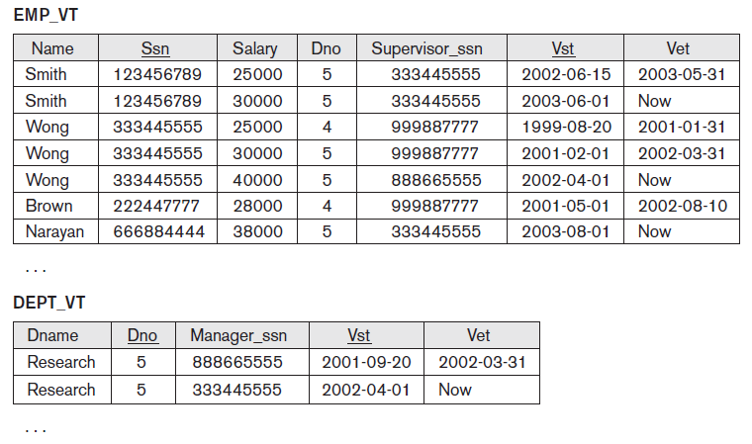
Temporal Database Concepts (6 of 12)
Figure 26.8 Some tuple versions in the valid time relations E M P_V T and D E P T_V T

Slide 22
Temporal Database Concepts (7 of 12)
Types of updates
Proactive
Retroactive
Simultaneous
Timestamp recorded whenever change is applied to database
Bitemporal relations
Application requires both valid time and transaction time

Slide 23
Temporal Database Concepts (8 of 12)
Implementation considerations
Store all tuples in the same table
Create two tables: one for currently valid information and one for the rest
Vertically partition temporal relation attributes into separate relations
New tuple created whenever any attribute updated
Append-only database
Keeps complete record of changes and corrections

Slide 24
Temporal Database Concepts (9 of 12)
Attribute versioning
Simple complex object used to store all temporal changes of the object
Time-varying attribute
Values versioned over time by adding temporal periods to the attribute
Non-time-varying attribute
Values do not change over time

Slide 25
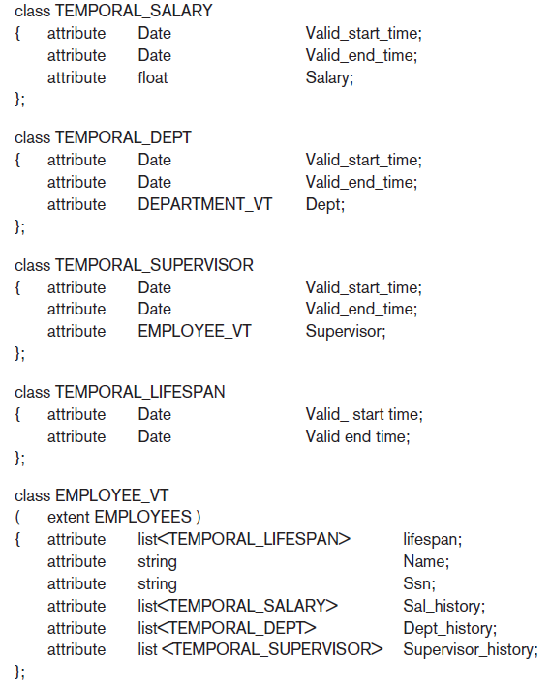
Figure 26.10 Possible O D L Schema for a Temporal Valid Time EMPLOYEE_V T Object Class Using Attribute Versioning

Slide 26
Temporal Database Concepts (10 of 12)
T S Q L2 language
Extends S Q L for querying valid time and transaction time tables
Used to specify whether a relation is temporal or nontemporal
Temporal database query conditions may involve time and attributes
Pure time condition involves only time
Attribute and time conditions

Slide 27

Temporal Database Concepts (11 of 12)
CREATE TABLE statement
Extended with optional AS clause
Allows users to declare different temporal options
Examples:
(valid time relation with valid time period)
AS TRANSACTION (transaction time relation with transaction time period)
Keywords STATE and EVENT
Specify whether a time period or point is associated with valid time dimension

Slide 28
Temporal Database Concepts (12 of 12)
Time series data
Often used in financial, sales, and economics applications
Special type of valid event data
Event’s time points predetermined according to fixed calendar
Managed using specialized time series management systems
Supported by some commercial D B M S packages

Slide 29
26.3 Spatial Database Concepts (1 of 8)
Spatial databases support information about objects in multidimensional space
Examples: cartographic databases, geographic information systems, weather information databases
Spatial relationships among the objects are important
Optimized to query data such as points, lines, and polygons
Spatial queries

Slide 30
Spatial Database Concepts (2 of 8)
Measurement operations
Used to measure global properties of single objects
Spatial analysis operations
Uncover spatial relationships within and among mapped data layers
Flow analysis operations
Help determine shortest path between two points

Slide 31
Spatial Database Concepts (3 of 8)
Location analysis
Determine whether given set of points and lines lie within a given polygon
Digital terrain analysis
Used to build three-dimensional models

Slide 32
Spatial Database Concepts (4 of 8)
Table 26.1 Common types of analysis for spatial data
Analysis Type | Type of Operations and Measurements
Measurements | Distance, perimeter, shape, adjacency, and direction
Spatial analysis/statistics | Pattern, autocorrelation, and indexes of similarity and topology using spatial and nonspatial data
Flow analysis | Connectivity and shortest path
Location analysis | Analysis of points and lines within a polygon
Terrain analysis | Slope/aspect, catchment area, drainage network
Search | Thematic search, search by region

Slide 33
Spatial Database Concepts (5 of 8)
Spatial data types
Map data
Geographic or spatial features of objects in a map
Attribute data
Descriptive data associated with map features
Image data
Satellite images
Models of spatial information
Field models
Object models

Slide 34
Spatial Database Concepts (6 of 8)
Spatial operator categories
Topological operators
Properties do not change when topological transformations applied
Projective operators
Express concavity/convexity of objects
Metric operators
Specifically describe object’s geometry
Dynamic spatial operators
Create, destroy, and update

Slide 35
Spatial Database Concepts (7 of 8)
Spatial queries
Range queries
Example: find all hospitals with the Metropolitan Atlanta city area
Nearest neighbor queries
Example: find police car nearest location of a crime
Spatial joins or overlays
Example: find all homes within two miles of a lake

Slide 36
Spatial Database Concepts (8 of 8)
Spatial data indexing
Grid files
R-trees
Spatial join index
Spatial data mining techniques
Spatial classification
Spatial association
Spatial clustering

Slide 37
26.4 Multimedia Database Concepts (1 of 2)
Multimedia databases allow users to store and query images, video, audio, and documents
Content-based retrieval
Automatic analysis
Manual identification
Color often used in content-based image retrieval
Texture and shape
Object recognition
Scale-invariant feature transform (S I F T) approach

Slide 38
Multimedia Database Concepts (2 of 2)
Semantic tagging of images
User-supplied tags
Automated generation of image tags
Web Ontology Language (O W L) provides concept hierarchy
Analysis of audio data sources
Text-based indexing
Content-based indexing

Slide 39
26.5 Introduction to Deductive Databases (1 of 4)
Deductive database uses facts and rules
Inference engine can deduce new facts using rules
Prolog/Datalog notation
Based on providing predicates with unique names
Predicate has an implicit meaning and a fixed number of arguments
If arguments are all constant values, predicate states that a certain fact is true
If arguments are variables, considered as a query or part of a rule or constraint

Slide 40
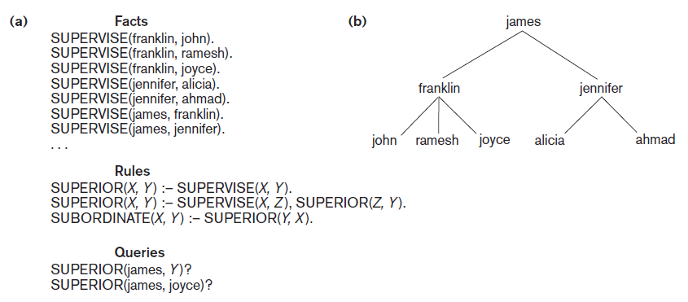
Prolog Notation and The Supervisory Tree
Figure 26.11 (a) Prolog notation (b) The supervisory tree

Slide 41
Introduction to Deductive Databases (2 of 4)
Datalog notation
Program built from basic objects called atomic formulas
Literals of the form
p is the predicate name
n is the number of arguments for predicate p
Interpretations of rules
Proof-theoretic versus model-theoretic
Deductive axioms
Ground axioms

Slide 42
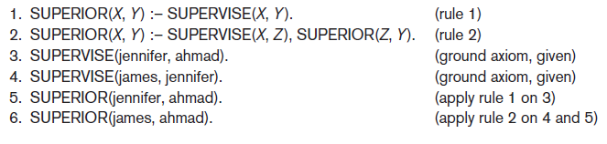
Introduction to Deductive Databases (3 of 4)
Figure 26.12 Proving a new fact

Slide 43
Introduction to Deductive Databases (4 of 4)
Safe program or rule
Generates a finite set of facts
Nonrecursive query
Includes only nonrecursive predicates

Slide 44
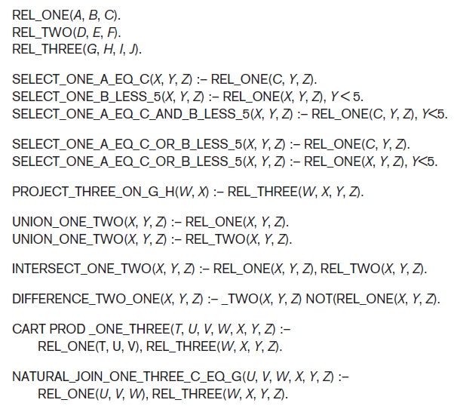
Use of Relational Operations
Figure 26.16 Predicates for illustrating relational operations

Slide 45
26.6 Summary
Active databases
Specify active rules
Temporal databases
Involve time concepts
Spatial databases
Involve spatial characteristics
Multimedia databases
Store images, audio, video, documents, and more
Deductive databases
Prolog and Datalog notation

Slide 46

Copyright

